Slide 1
What is AI?
The Learning Machine
Notes:
Hello and welcome to: “Frontiers of AI
In this class, we will explore the question of AI and its relationship to our world. We created this class specifically for STUDENTS who are curious about AI but wonder how it applies to the program of study they are presently engaged in. The great news is that you do not need to have a strong technical or mathematical background to do interesting AI-enabled research. Our motto is: AI for Everyone!
So, let’s start with some basic definitions…

Slide 2
How do machines learn?
Notes:
Here’s our essential question for today’s class. Please keep this question in mind as we work through today’s presentation and activities.

Slide 3
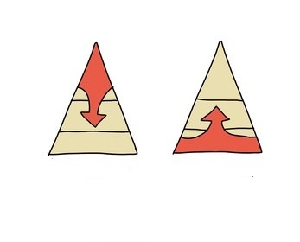
top-down bottom-up
Notes:
Interestingly, the major computational approaches to AI were all established from the 1950’s to the 1970’s, and they can be grouped into two basic categories. Top-down and Bottom-up methods.

Slide 4

top-down
Notes:
Let’s first consider the top-down approach, with the following characteristics:
Focus on knowledge, problem decomposition, symbolic (abstract) reasoning, and problem-solving algorithms.
AI achieved by direct engineering.
Let’s first take a look at a couple top-down AI examples.

Slide 5

Can the orange-chinned parakeet fly?
Laura Gaudette (CC-BY)
Knowledge base
Birds can fly (0.99).
A parrot is a bird.
The orange-chinned parakeet is a parrot.
…
Q: Can the orange-chinned parakeet fly?
Inference Engine
A: The orange-chinned parakeet most likely can fly.

Slide 6
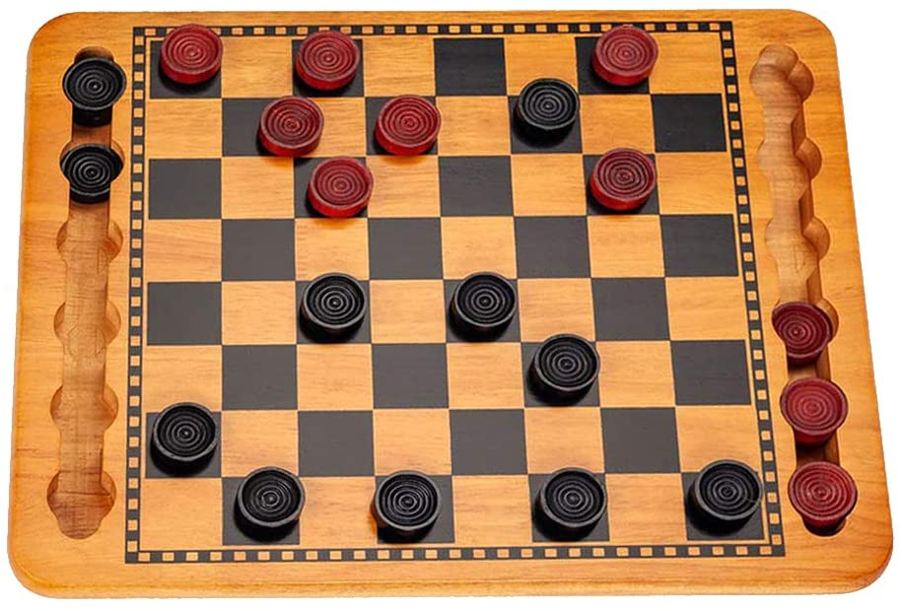
What is red's next move?
Game tree search
next move
Game board representation
Position evaluator
Rule-based pruning

Slide 7
Top-Down (Summary)
Notes:
Focus on knowledge, problem decomposition, symbolic (abstract) reasoning, and problem-solving algorithms.
AI achieved by direct engineering.
Examples: “common sense” reasoning, playing checkers

Slide 8

bottom-up
Notes:
And now, let’s consider a bottom-up example…

Slide 9

Cat or Dog?
Mathematical function mapping image to label (“cat” or “dog”)
cat
Notes:
Now for the bottom-up approach to AI. Here we feature a classification example – Is this a dog or cat?
Focus on inputs (e.g., data, environment) and low-level methods of processing.
AI achieved by learning, self-organization, or optimization.

Slide 10

Cat or Dog?
Mathematical function mapping image to label (“cat” or “dog”)
E.g.: y = mx + b
Special numerical values in the function are “knobs” we can turn to adjust the outputs.

Slide 11
Cat or Dog?
Mathematical function mapping image to label (“cat” or “dog”)

Slide 12
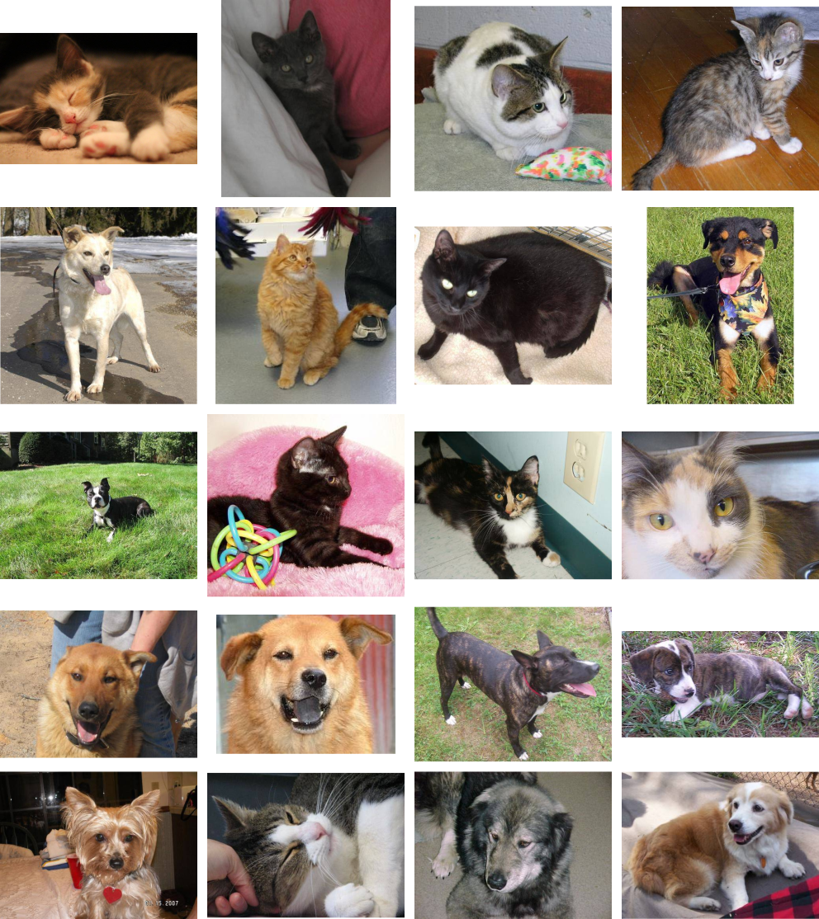
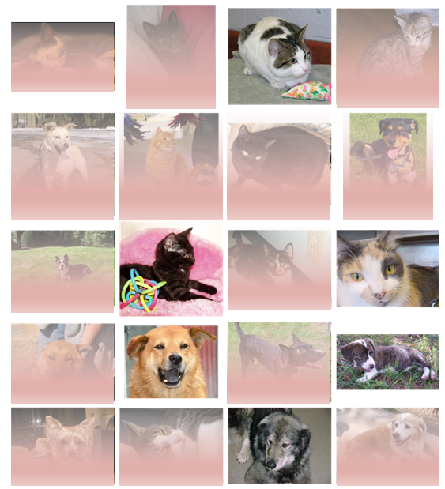

Cat or Dog?
Mathematical function mapping image to label (“cat” or “dog”)
Training algorithm

Slide 13

Cat or Dog?
Mathematical function mapping image to label (“cat” or “dog”)
Training algorithm

Slide 14
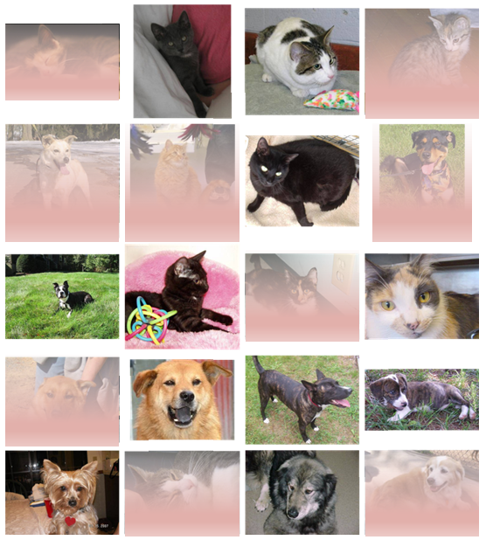
Cat or Dog?
Mathematical function mapping image to label (“cat” or “dog”)
Training algorithm

Slide 15

Cat or Dog?
Mathematical function mapping image to label (“cat” or “dog”)
Training algorithm

Slide 16
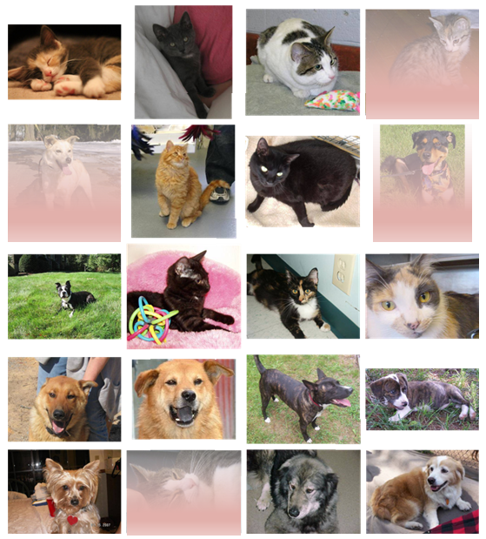
Cat or Dog?
Mathematical function mapping image to label (“cat” or “dog”)
Training algorithm

Slide 17
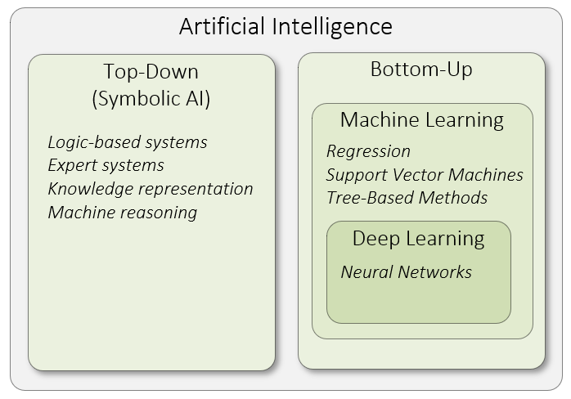
Notes:
Let’s summarize what we’ve covered so far. As pictured here, AI is a broad field of study with two distinct approaches to intelligence. Within the bottom-up approach, deep learning has emerged as a sub-field of machine learning within the past decade. Interestingly, AI has a long and distinguished history. In fact, a lot of important AI research happened in the 1950s.
Keep in mind that top-down or symbolic AI systems do not learn. In other words, all the knowledge the system needs to function is built into the system upfront. That was certainly the case with the expert systems I worked on in the 1980’s. Knowledge was typically represented as rules of thumb, otherwise known as heuristics, in these systems. At that time, most AI work was done in the Prolog or Lisp programming languages.
So, artificial intelligence (AI) is the overarching discipline that concerns itself with the development of computer systems capable of performing tasks that humans are good at; for example, recognizing objects, making sense of speech, and decision making in a constrained environment.
Machine learning is the field of AI that applies statistical methods to enable computer systems to learn from data to achieve an end goal.
And finally, deep learning is a field of machine learning which focuses on neural networks. A neural network is a special type of learning algorithm, inspired by the billions of interconnected neurons in the human brain.

Slide 18
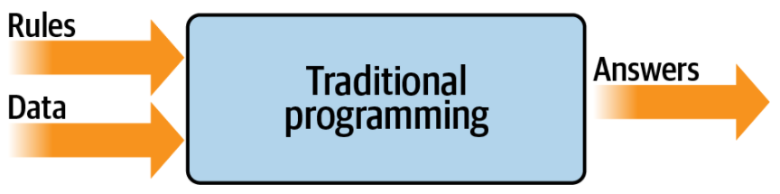
Notes:
Now that we’ve worked through an example and defined terms, let’s consider how traditional programming differs from machine learning. Don’t worry – we’re not going to get technical here. In traditional programming as pictured here, you have rules expressed in a programming language. These rules act on data, and the result is answers.
The model pictured here has been the backbone of development since its inception. But it has an inherent limitation: namely, that only scenarios that can be implemented are ones for which you can derive rules. What about other scenarios? Usually, they are infeasible to develop because the code is too complex. It’s just not possible to write code to handle them.
Let’s consider a concrete example…

Slide 19
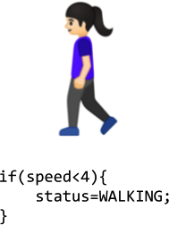
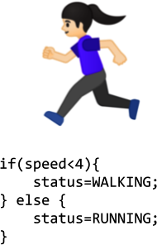
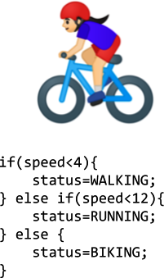

Notes:
Take, for example, activity detection. Fitness monitors that can detect our activity are a recent innovation, not just because of the availability of cheap and small hardware, but also because the algorithms to handle detection weren’t previously feasible. Let’s explore why.
In the first case, we see a naive activity detection algorithm for walking. It can consider the person’s speed. If it’s less than a particular value, we can determine that they are probably walking. Given that our data is speed, we could extend this to detect if they are running, as in the 2nd case.
As you can see, going by the speed, we might say if it is less than a particular value (say, 4 mph) the person is walking, and otherwise they are running. It still sort of works. Now suppose we want to extend this to another popular fitness activity, biking. The algorithm might look like that in the 3rd case.. I know it’s naive in that it just detects speed—some people run faster than others, and you might run downhill faster than you cycle uphill, for example. But on the whole, it still works.
However, what happens if we want to implement another scenario, such as golfing, in case #4?
We’re now stuck. How do we determine that someone is golfing using this methodology? The person might walk for a bit, stop, do some activity, walk for a bit more, stop, etc. But how can we tell this is golf? Our ability to detect this activity using traditional rules has hit a wall. But maybe there’s a better way.
Enter machine learning.

Slide 20
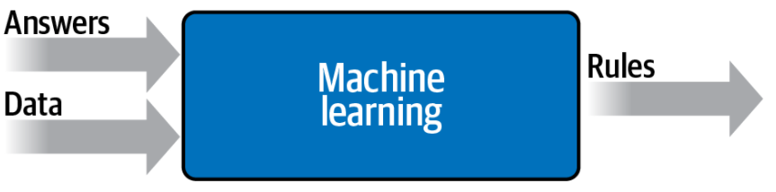
Notes:
Let’s take another look at the diagram we used to demonstrate what traditional programming is. Here we have rules that act on data and give us answers. In our activity detection scenario, the data was the speed at which the person was moving; from that we could write rules to detect their activity, be it walking, biking, or running. We hit a wall when it came to golfing, because we couldn’t come up with rules to determine what that activity looks like.
But what would happen if we were to flip the axes around on this diagram? Instead of coming up with the rules, what if we were to come up with the answers, and along with the data have a way of figuring out what the rules might be? The bottom image shows what this would look like. We can consider this high-level diagram to define machine learning.
So, what are the implications of this? Well, now instead of us trying to figure out what the rules are, we get lots of data about our scenario, we label that data, and the computer can figure out what the rules are that make one piece of data match a particular label and another piece of data match a different label.

Slide 21
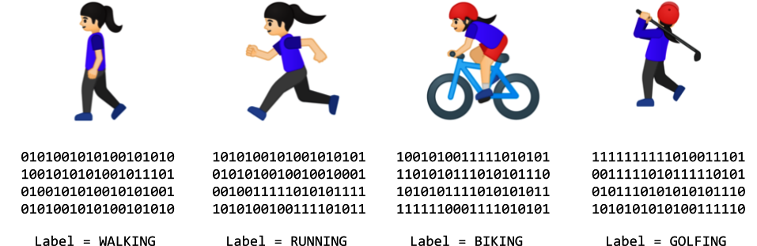
Notes:
How would this work for our activity detection scenario? Well, we can look at all the sensors that give us data about this person. If they have a wearable that detects information such as heart rate, location, speed, etc.—and if we collect a lot of instances of this data while they’re doing different activities—we end up with a scenario of having data that says, “This is what walking looks like,” “This is what running looks like,” and so on..
Now our job changes from figuring out the rules to creating the machine learning models that can match the data to the labels.

Slide 22
Summary
Notes:
Okay – let’s quickly summarize what we covered in today’s workshop.

Slide 23
References
Moroney, L. (2019). AI and Machine Learning for Coders: A Programmer’s Guide to Artificial Intelligence. Sebastopol, CA: O’Reilly Media, Inc.

